Slide 1

DIGITEKISI
DATABASE DESIGN AND IMPLEMENTATION
Notes:
INTRODUCTION

Slide 2
DESIGN PHASE
SYSTEM OVERVIEW
ENTITIES AND RELATIONSHIPS
DIGITEKISI
DATABASE SCHEMA
ER DIAGRAM
IMPLEMENTATION
CONCLUSION
ER DIAGRAM
THANKYOU
Notes:
TABLE OF CONTENTS

Slide 3
SYSTEM OVERVIEW
Our system aims to revolutionize the transportation industry by connecting passengers with drivers in real-time. By leveraging advanced positioning technologies, we provide a user-friendly platform that ensures timely pickups and drop-offs for passengers, and optimized routes for drivers.
This was central to the design and implementation of our database
Notes:
OVERVIEW

Slide 4
THE ENTITIES
To build a robust database, we need to identify the main entities and their relationships. In DIGITEKISI, we have four key entities:
Passenger: Represents individuals who request rides.
Driver: Represents individuals who provide rides.
Ride: Represents a specific ride requested by a passenger and accepted by a driver.
Location: Represents a specific location or address.
Notes:
TABLE OF CONTENTS

Slide 5
THE RELATIONSHIPS
One passenger can have multiple rides.
rELATIONSHIPS
One driver can have multiple rides.
Each ride has a pickup location and a drop-off location.
Each ride has a passenger and a driver associated with it.
Notes:
TABLE OF CONTENTS

Slide 6
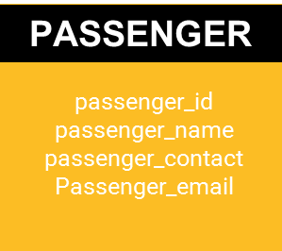
PASSENGER TABLE
This table will store information about our passengers, such as their unique ID, name, contact information, and any other relevant details.
Notes:
TABLE OF CONTENTS

Slide 7
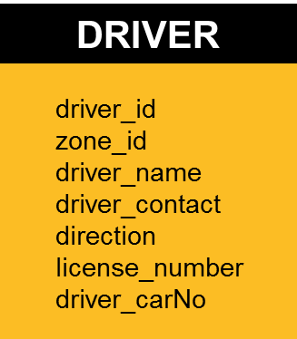
DRIVER TABLE
Here, we will store data about our drivers, including their unique ID, name, contact information, and potentially other details such as their vehicle type, license information, and rating.
Notes:
TABLE OF CONTENTS

Slide 8
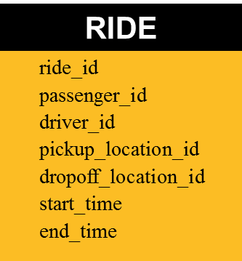
TRIP/RIDE TABLE
The Ride table is a crucial component of our database. It captures information about each ride, including a unique:
Notes:
TABLE OF CONTENTS

Slide 9
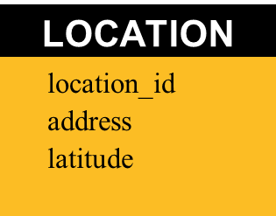
LOCATION TABLE
This table will store information about various locations, including their unique ID:
Notes:
TABLE OF CONTENTS

Slide 10
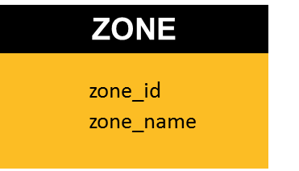
ZONE TABLE
The Zone Table:
Notes:
TABLE OF CONTENTS

Slide 11
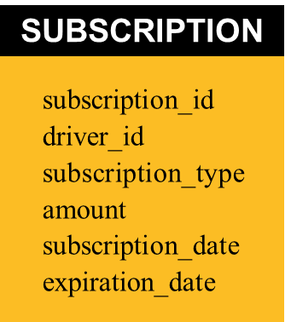
SUBSCRIPTIONS TABLE
The Subscriptions table:
Notes:
TABLE OF CONTENTS

Slide 12
DATABASE SCHEMA
As we've discussed the individual tables, let's take a look at the overall database schema. This schema visually represents the relationships between the tables and how they interact with each other. The schema provides a clear understanding of the structure and organization of our database
Notes:
TABLE OF CONTENTS

Slide 13
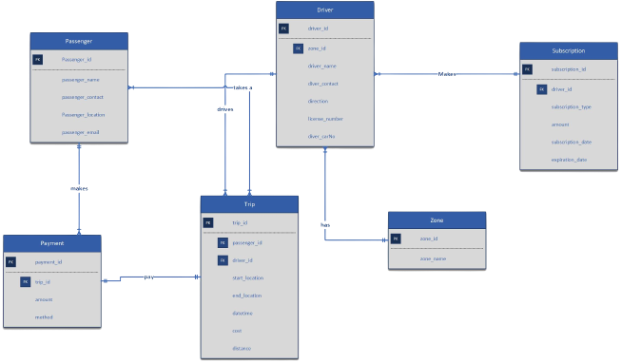
ER DIAGRAM
Notes:
TABLE OF CONTENTS

Slide 14
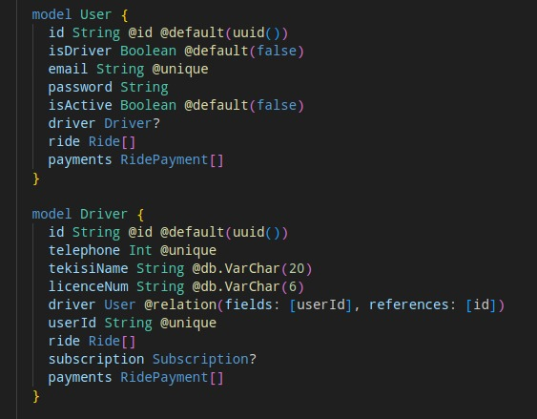
DATABASE IMPLEMENTATION
Notes:
TABLE OF CONTENTS

Slide 15
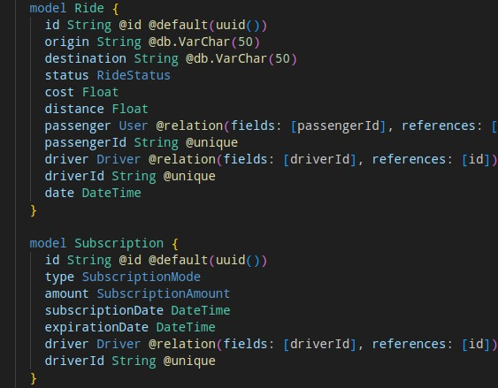
DATABASE IMPLEMENTATION
Notes:
TABLE OF CONTENTS

Slide 16
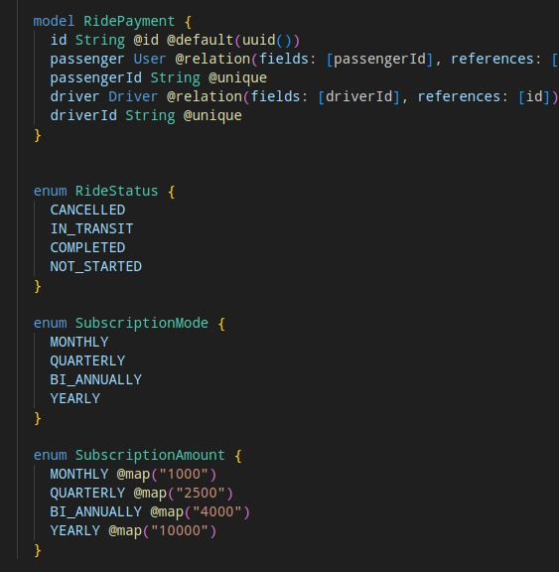
DATABASE IMPLEMENTATION
Notes:
TABLE OF CONTENTS

Slide 17
QUERYING AND REPORTING
In addition to basic operations, our database will support advanced querying and reporting functionalities. Passengers will be able to view their ride history, access fare details, and generate reports based on specific criteria. Drivers can also access reports on their earnings, ratings, and performance metrics, allowing them to track their progress and make informed decisions.
Notes:
TABLE OF CONTENTS

Slide 18

CONCLUSION
Concluding, a well-designed and implemented database is vital for the success of DIGITEKISI. By efficiently managing passenger and driver data, we can provide a seamless and reliable transportation experience. Our database will ensure accurate matching, timely pickups, and optimized routes, ultimately enhancing the overall user satisfaction.
Notes:
TABLE OF CONTENTS

Slide 19
THANK YOU
FOR YOUR
ATTENTION!!!
Notes:
TABLE OF CONTENTS

